Slide 1
Predicting the thermodynamic effect of mutations on a genome-wide scale
Alexey Strokach

Slide 2
Overview
Introduction
Implementation
ELASPIC database
Homology modelling of the human proteome
ELASPIC pipeline
ELASPIC REST API
Results
Grid-search (to find a good set of parameters)
Feature elimination
Discussion
What have we learned?
Future directions

Slide 3
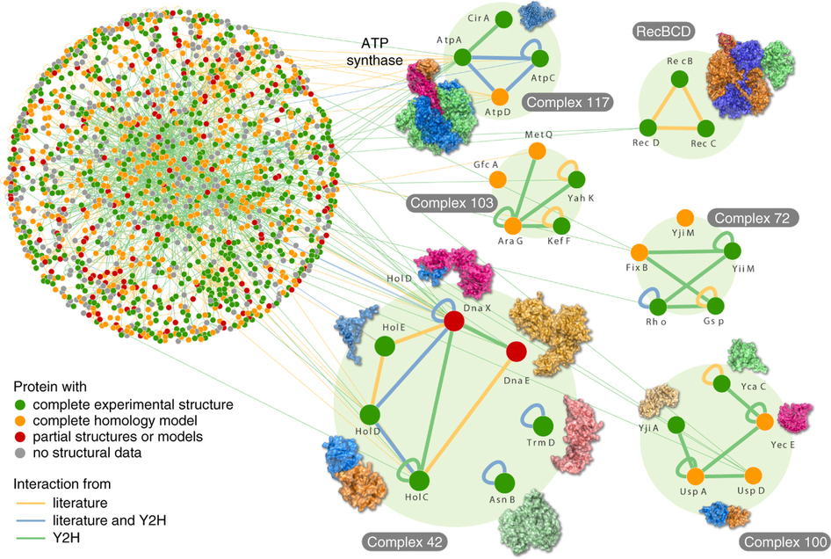
Overview
Goal: Predict the effect of mutations on protein stability and protein interaction affinity on a genome-wide scale.
Rajagopala S. et al., Nature Biotech., 2014
Profs
Accurate domain definitions for all proteins in a given organism.
Structural templates for domains and domain-domain interactions.
ELASPIC
Homology models of domains and domain interactions.
A classifier trained to predict the effect of mutations on protein stability and protein interaction affinity.

Slide 4
Overview
ELASPIC background and progress
Alanine scanning of PPI interfaces
Correlation with disorderome peptide dropout scores
Validation of ELASPIC results using histone interaction data
Future directions

Slide 5
ELASPIC
Evaluating the impact of mutations on protein stability and protein-protein affinity.

Slide 6
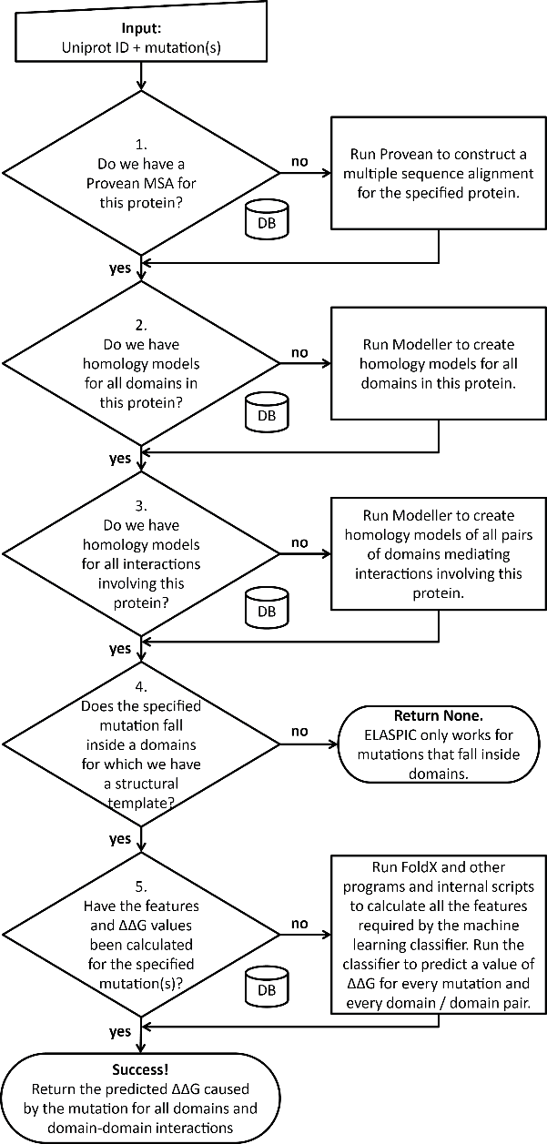
ELASPIC background

Slide 7

ELASPIC background

Slide 8
ELASPIC background

Slide 9
xxx

Slide 10
ELASPIC background

Slide 11
ELASPIC background

Slide 12
ELASPIC background

Slide 13
ELASPIC background

Slide 14
ELASPIC background

Slide 16
Progress pre-calculating alignments and models
Provean
supporting sets
Uniprot domains
(human)
Uniprot domain pairs
(human)

Slide 17
Progress pre-calculating mutations
Provean
supporting sets
Uniprot domains
(human)
Uniprot domain pairs
(human)

Slide 19
Overview
ELASPIC background and progress
Alanine scanning of PPI interfaces
Correlation with disorderome peptide dropout scores
Validation of ELASPIC results using histone interaction data
Future directions

Slide 20
Results from

Slide 22
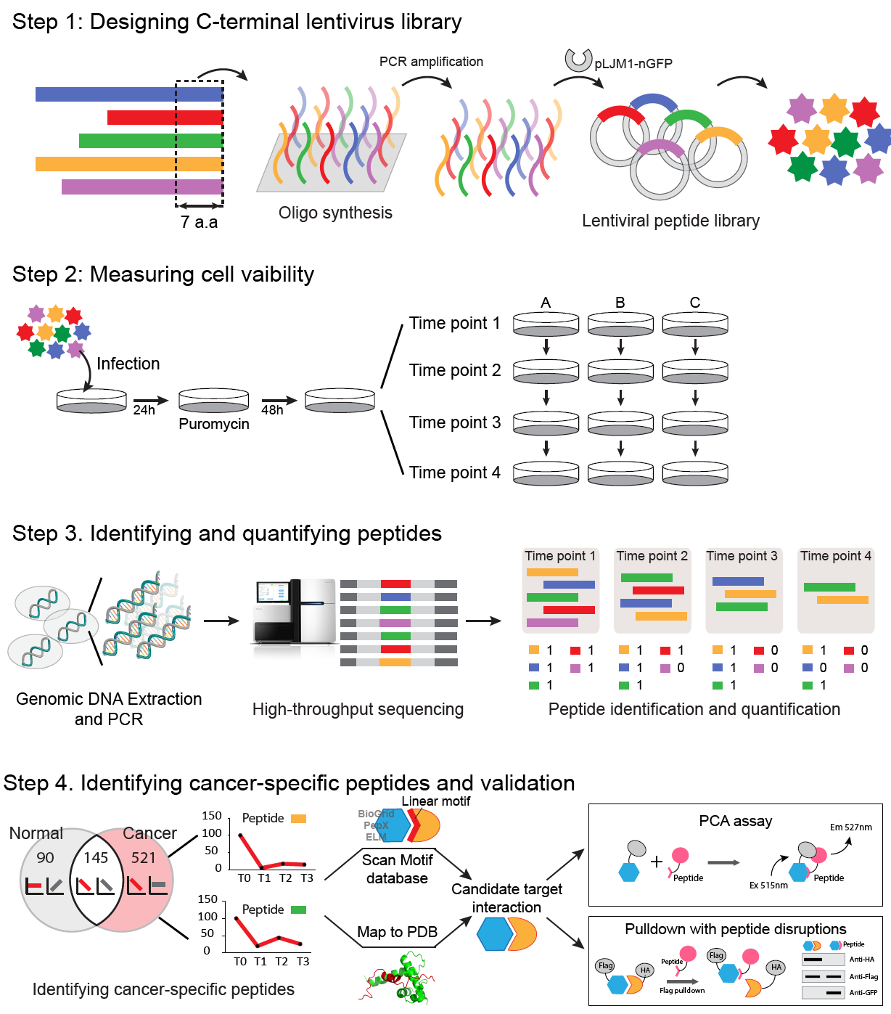
Identifying anti-proliferative peptides
By Satra Nim & Juhyun Clare Jeon

Slide 23

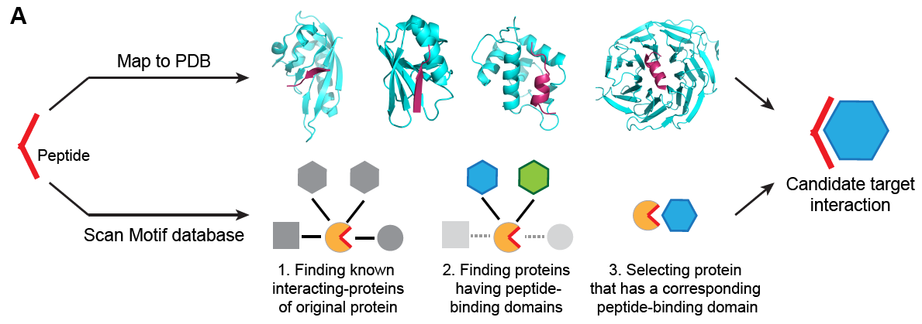

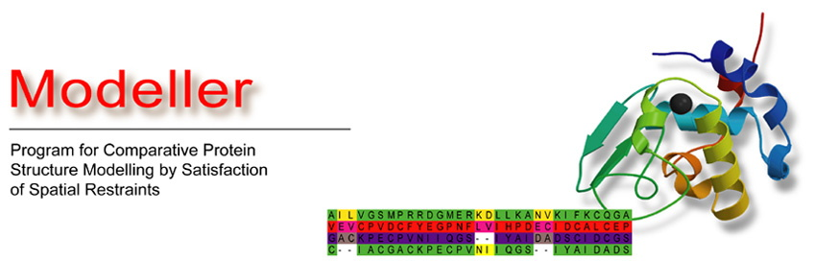
Mapping anti-proliferative peptides to structures
Potential Pairs
Target-Peptide
9,944
Map to DDI
models
+
PSIBLAST
+
HIPPIE
By Carles Corbi

Slide 24
Examples of models with disorderome peptides

Slide 25
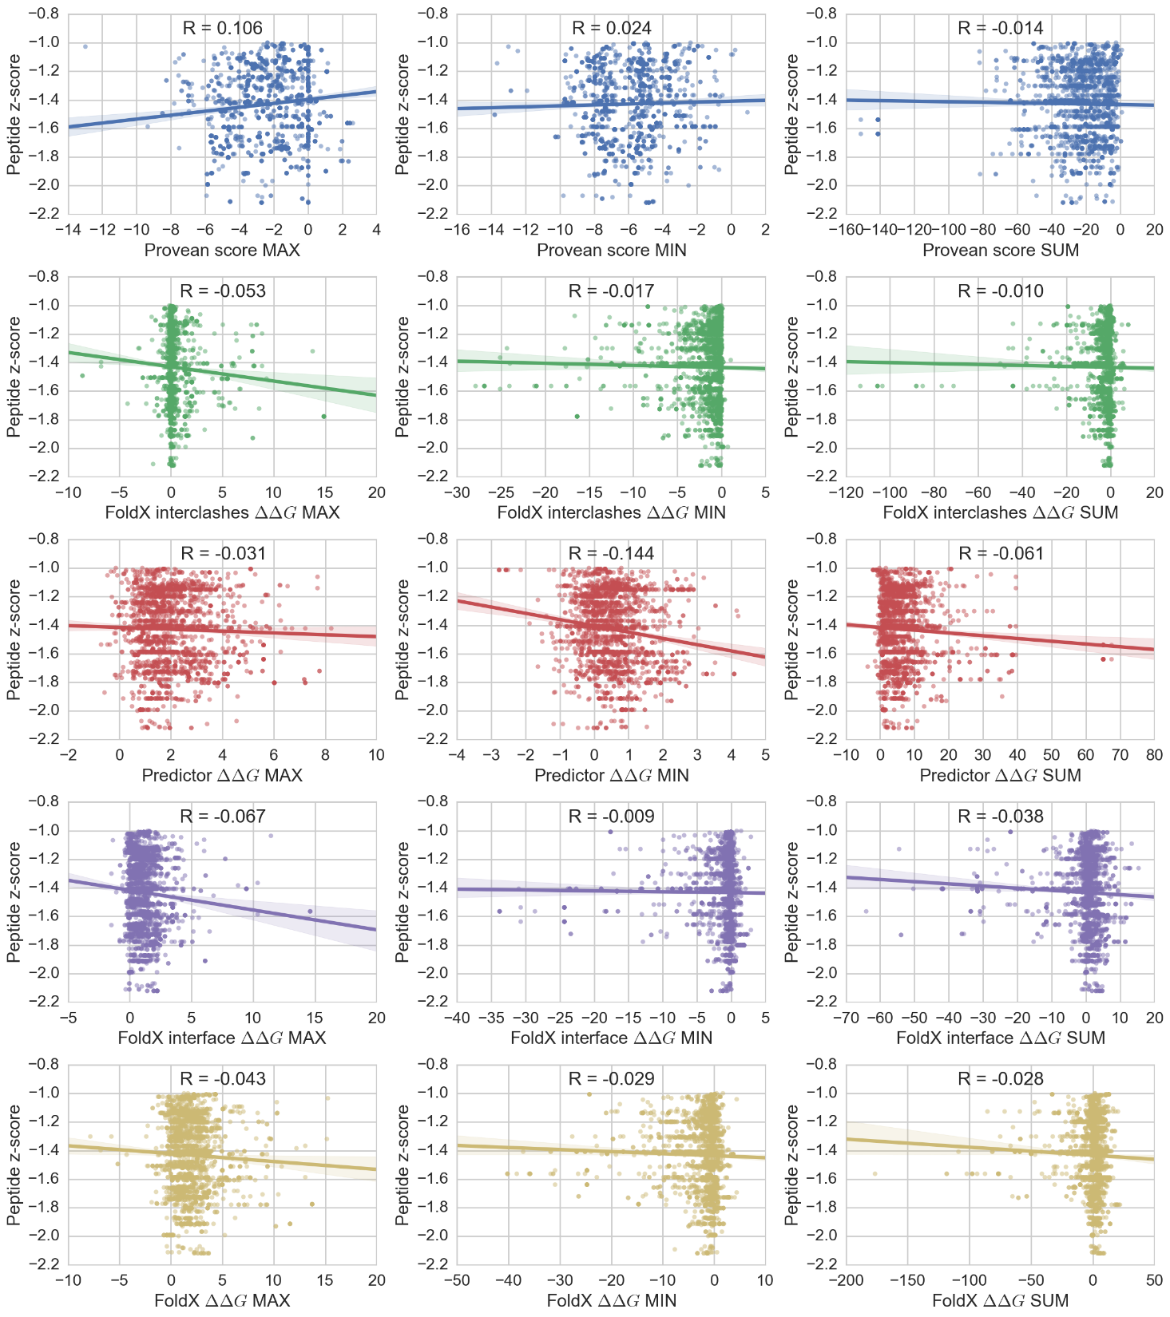
Correlation between features and dropout z-score

Slide 28
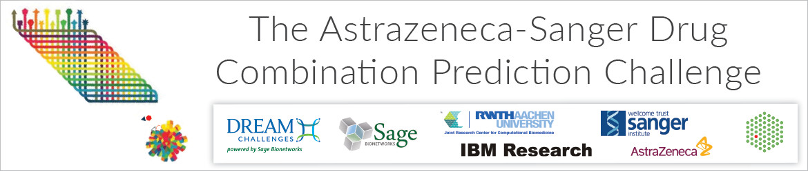
Future directions
~30k experimentally tested drug combinations measuring cell viability over 140 drugs and 120 cancer cell lines (primarily colon, lung, and breast), and monotherapy drug response data for each drug and cell line.
Genomic data including gene expression, somatic mutation, copy-number alterations, and methylation data.

Slide 29
Future directions
VCF
SNPEff
ANNOVAR
EnsEMBL VEP

Slide 30

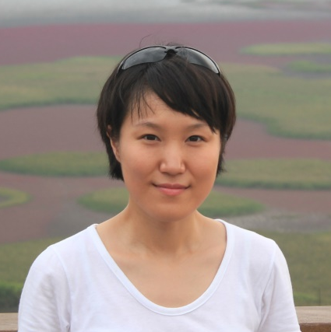
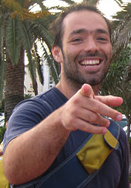
Acknowledgements
Supervisor:
Philip M. Kim
Members of kimlab:
Recep Colak
Carles Corbi
Michael Garton
Clare Juhyun Jeon
Mark Sun
Joan Teyra
Project students:
Niklas Berliner
Andres Felipe Giraldo Forero
Hanif Jetha
Sebastian Garcia Lopez
Daniel Witvliet
Clare Juhyun Jeon
Joan Teyra

Slide 31
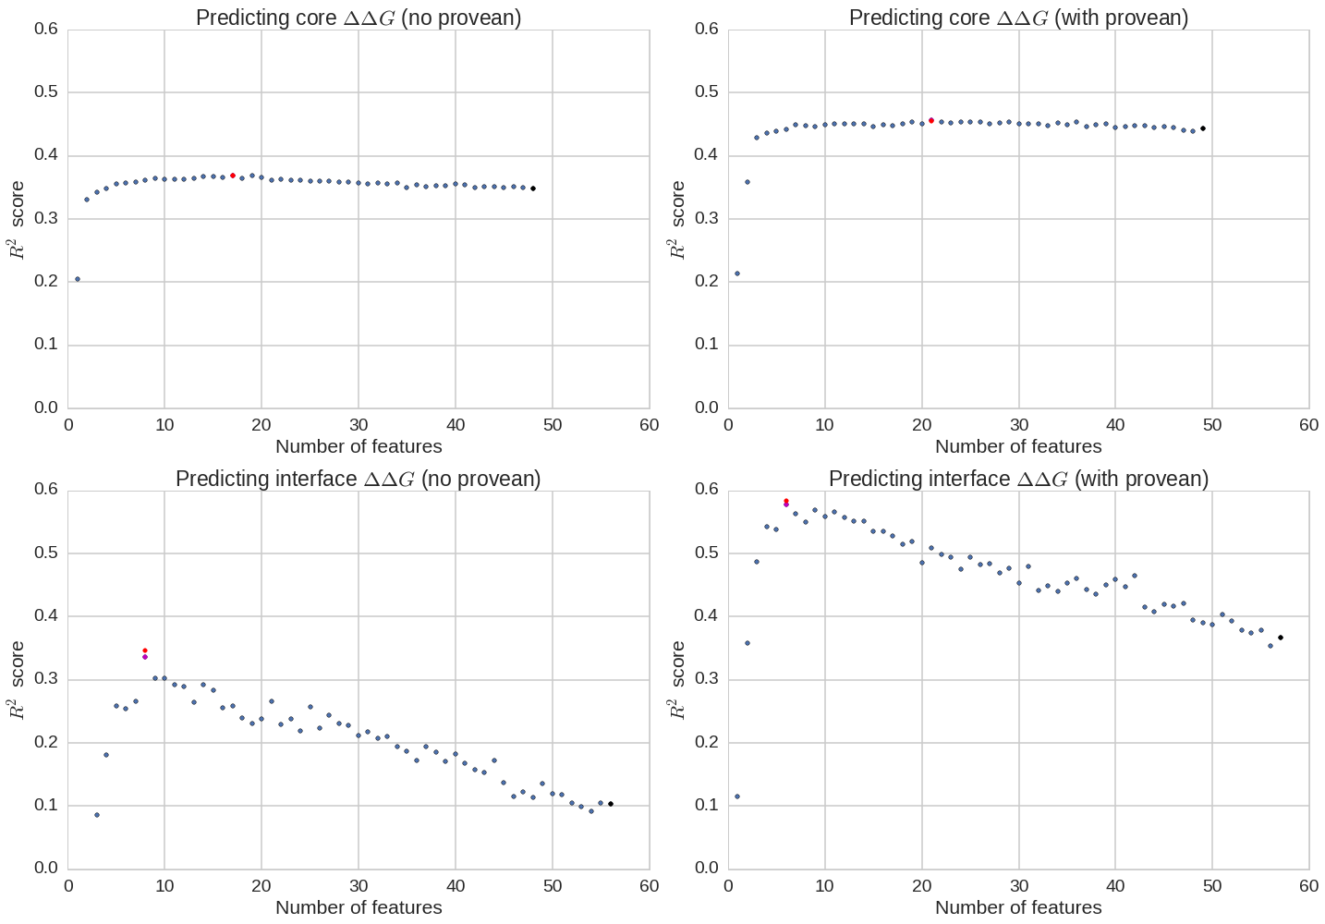
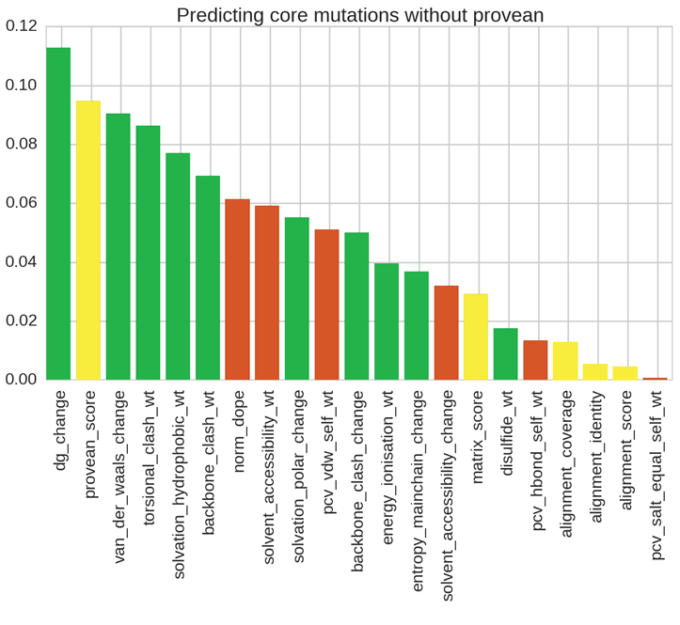
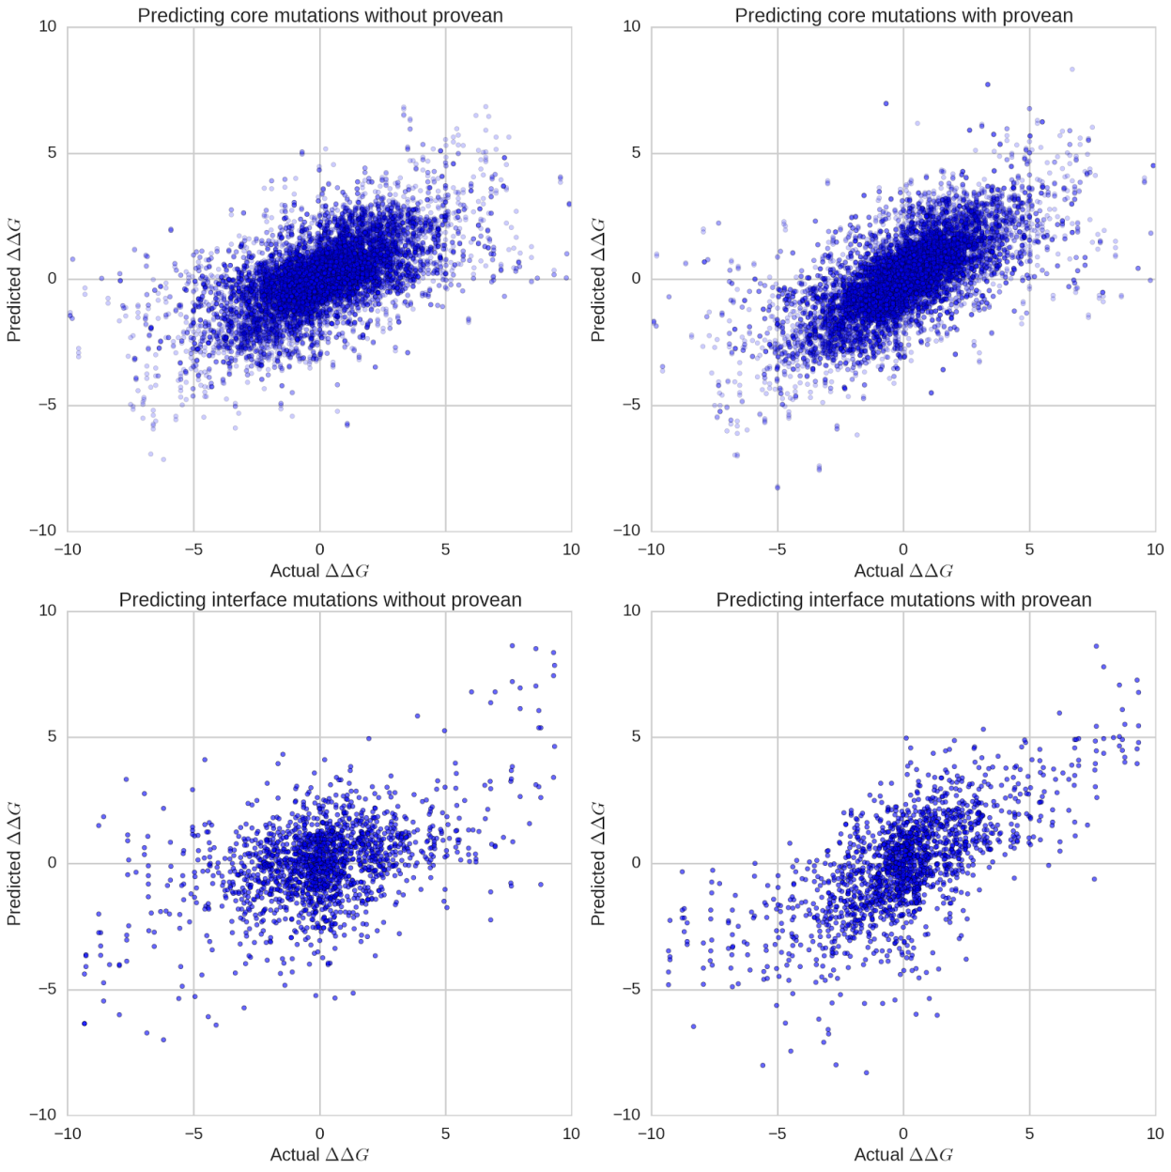
Predicting the effect of CORE mutations
R² = 0.46

Slide 32
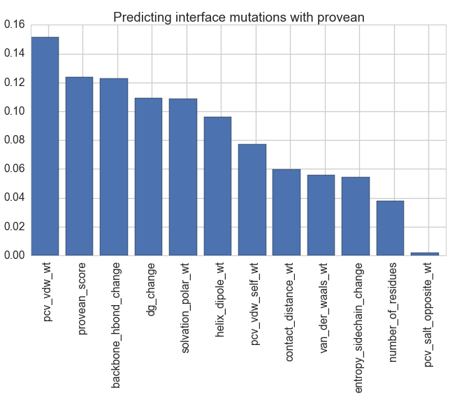
Predicting the effect of INTERFACE mutations
R² = 0.55

Slide 33
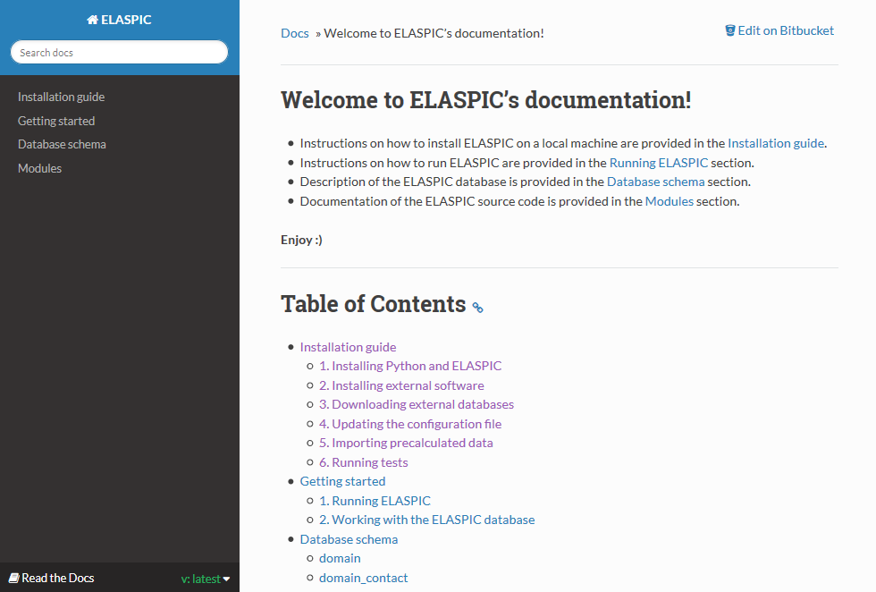
ELASPIC documentation

Slide 34
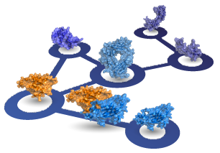
Predicting the thermodynamic effect of mutations
Correct domain boundaries:
PDBFam
ELASPIC pipeline
For every domain in every Uniprot:
Find a structural template for every PDBfam domain in Uniprot
Filter the PPI network, keeping interactions for which a domain-domain contact structure is available
Create homology models for single domains or domain-domain pairs
Compile a list of biophysical and biochemical properties (for each mutation)
Predict the ∆∆G of the mutation
∆G of domain
Mutation ∆∆G of domain folding
PPI network:
Hippie
∆G of protein interaction
Domain structures:
PDB / PDBfam
Mutation ∆∆G of protein interaction
Domain contact structures:
SCOWLP / PDBFam
- Tissue-specific PPI networks (splicing and expression levels)
- Protein function and phenotypic effect of mutations
interactome3d.irbbarcelona.org

Slide 35
Core
Uniprot Domain
Uniprot Domain
Template
Uniprot Domain
Model
Uniprot Domain
Mutation
Uniprot domain id
Uniprot accession
PDBfam name
PDBfam domain definition
Uniprot domain id
- Expanded domain definitions
- Pairwise sequence alignment filename
- Multiple sequence alignment filename
Uniprot domain id
- Model filename
- DOPE score
- dG of folding (FoldX)
Uniprot domain id
- Mutation
- Biophysical properties
- SASA score
- SIFT / PROVEAN score
…
∆∆G score
Profs domain template
Cath id
PDB id
PDB chain
PDB domain definition
PDBfam name
PDBfam clan
Interface (Protein-Protein)
Uniprot Domain Pair
Uniprot Domain
Pair Template
Uniprot Domain
Pair Model
Uniprot Domain
Pair Mutation
Uniprot domain pair id
Uniprot domain id 1
Uniprot domain id 2
Path to data
Type of interaction…
Uniprot domain pair id
- Expanded domain definitions
- Pairwise sequence alignment filenames
Uniprot domain pair id
- Model filename
- DOPE score
- Interface area
- Interacting residue
- dG of interaction (FoldX)
Uniprot domain pair id
- Mutation
- Biophysical properties
- SASA score
- SIFT / PROVEAN score
…
∆∆G score
PDBFam domain contacts
Domain contact id
Cath id 1
PDB contacting residues 1
Cath id 2
PDB contacting residues 2

Slide 36
Core
Uniprot Domain
Uniprot Domain
Template
Uniprot Domain
Model
Uniprot Domain
Mutation
Uniprot domain id
Uniprot accession
PDBfam name
PDBfam domain definition
Uniprot domain id
- Expanded domain definitions
- Pairwise sequence alignment filename
- Multiple sequence alignment filename
Uniprot domain id
- Model filename
- DOPE score
- dG of folding (FoldX)
Uniprot domain id
- Mutation
- Biophysical properties
- SASA score
- SIFT / PROVEAN score
…
∆∆G score
Profs domain template
Cath id
PDB id
PDB chain
PDB domain definition
PDBfam name
PDBfam clan
Interface (Protein-Protein)
Uniprot Domain Pair
Uniprot Domain
Pair Template
Uniprot Domain
Pair Model
Uniprot Domain
Pair Mutation
Uniprot domain pair id
Uniprot domain id 1
Uniprot domain id 2
Path to data
Type of interaction…
Uniprot domain pair id
- Expanded domain definitions
- Pairwise sequence alignment filenames
Uniprot domain pair id
- Model filename
- DOPE score
- Interface area
- Interacting residue
- dG of interaction (FoldX)
Uniprot domain pair id
- Mutation
- Biophysical properties
- SASA score
- SIFT / PROVEAN score
…
∆∆G score
Profs domain contacts
Domain contact id
Cath id 1
PDB contacting residues 1
Cath id 2
PDB contacting residues 2

Slide 37
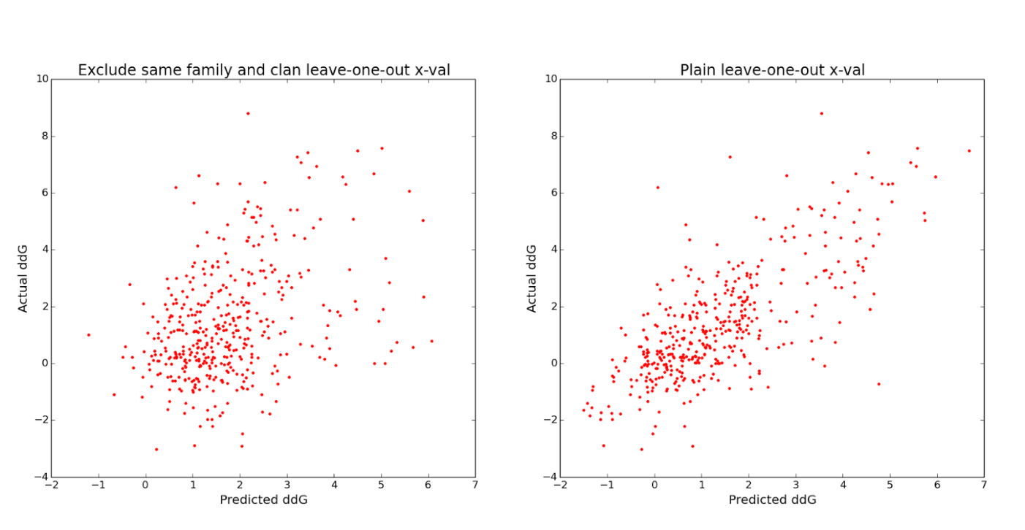

Predicting the ddG of interface mutations
As a training set, we used the Skempi database, which contains ddG values for 862 interface mutations in crystallized protein complexes.
Leave-one-out cross-validation while excluding members of the same pfam family and clan from the training set results in a correlation coefficient of 0.37, mainly because most cross-validation bins have < 100 training points.
Naïve leave-one-out cross-validation results in a correlation coefficient of 0.74 .

Slide 38
Talk Overview
CSC2534 - Decision Making Under Uncertainty
Combining proteins and diseases in a probabilistic graphical network
ELASPIC
Using structural and functional features to predict the phenotypic consequence of mutations

Slide 39
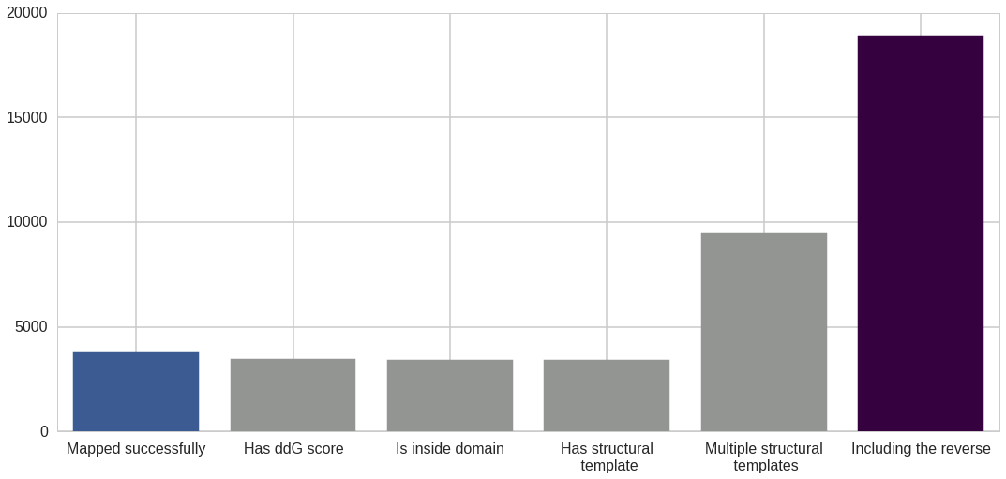
Creating the core and interface training sets
Mapping mutations from Protherm / Skempi and from small-scale studies
Filtering out mutations that don’t fall inside domains
Making homology models of different sequence identities
Reversing the mutation and running the pipeline for mut -> wt
Parsing core mutations

Slide 40
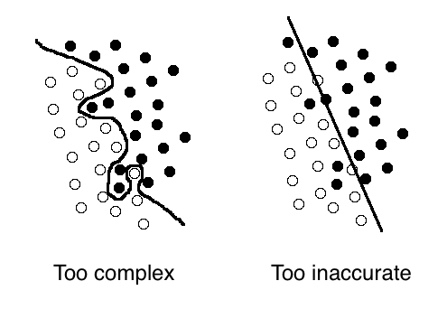
Training the core and interface classifiers
Perform grid-search to find the best hyperparameters using all features
Perform recursive feature elimination to remove features that are not important
Perform grid-search again to find the best hyperparameters when using the final set of features
Train the final classifiers

Slide 41
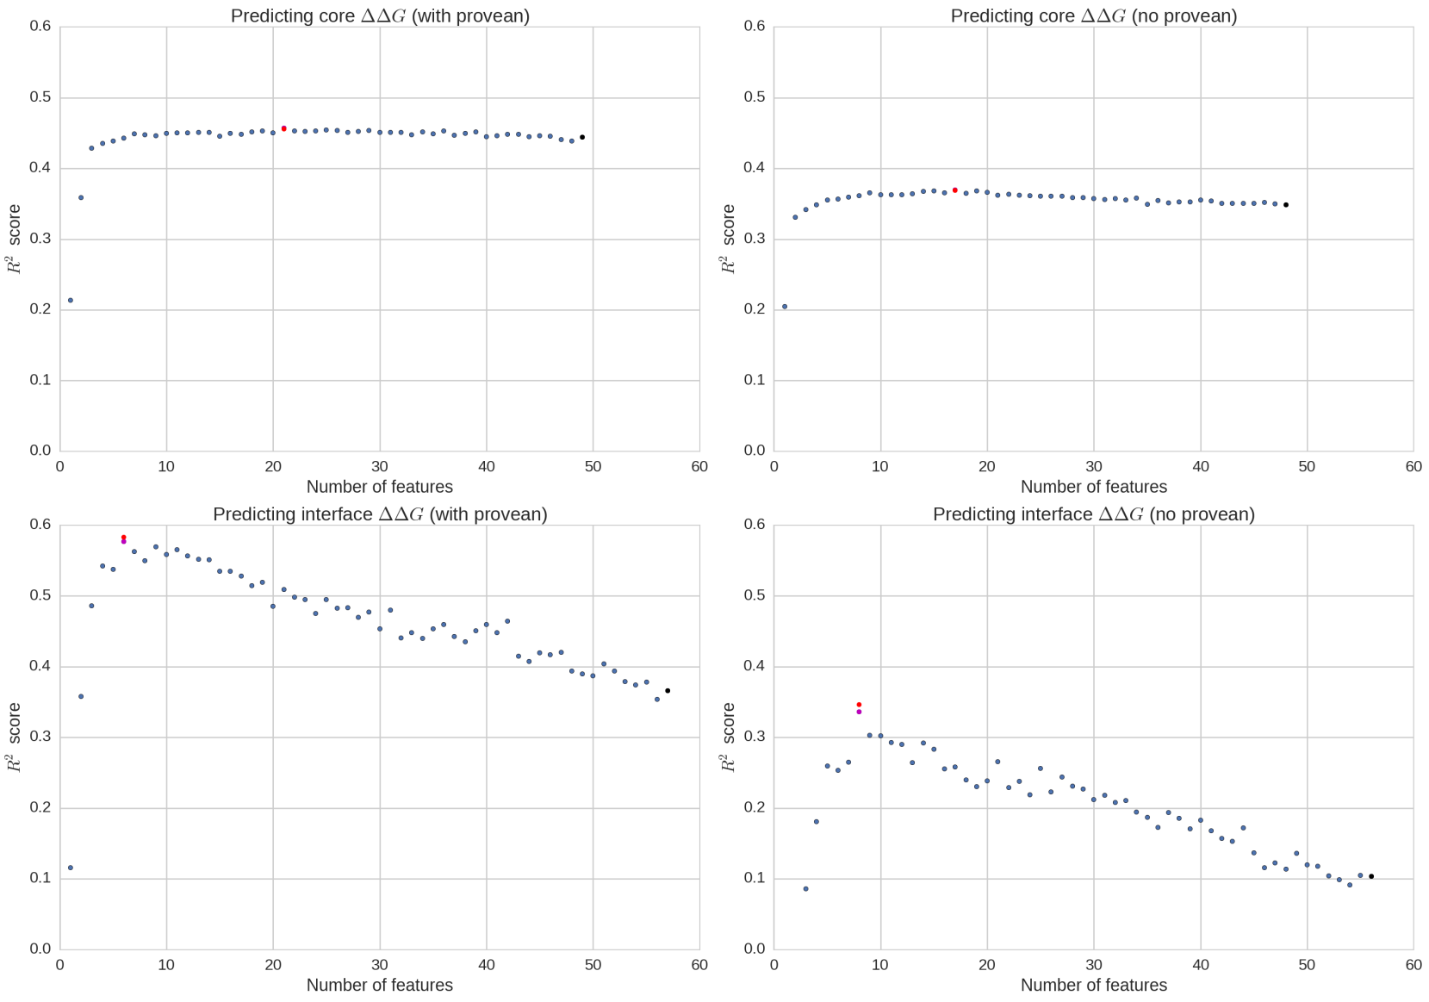
Recursive feature elimination
Provean No reverse mutations
No Provean
Reverse mutations
Core mutations
Interface mutations

Slide 42
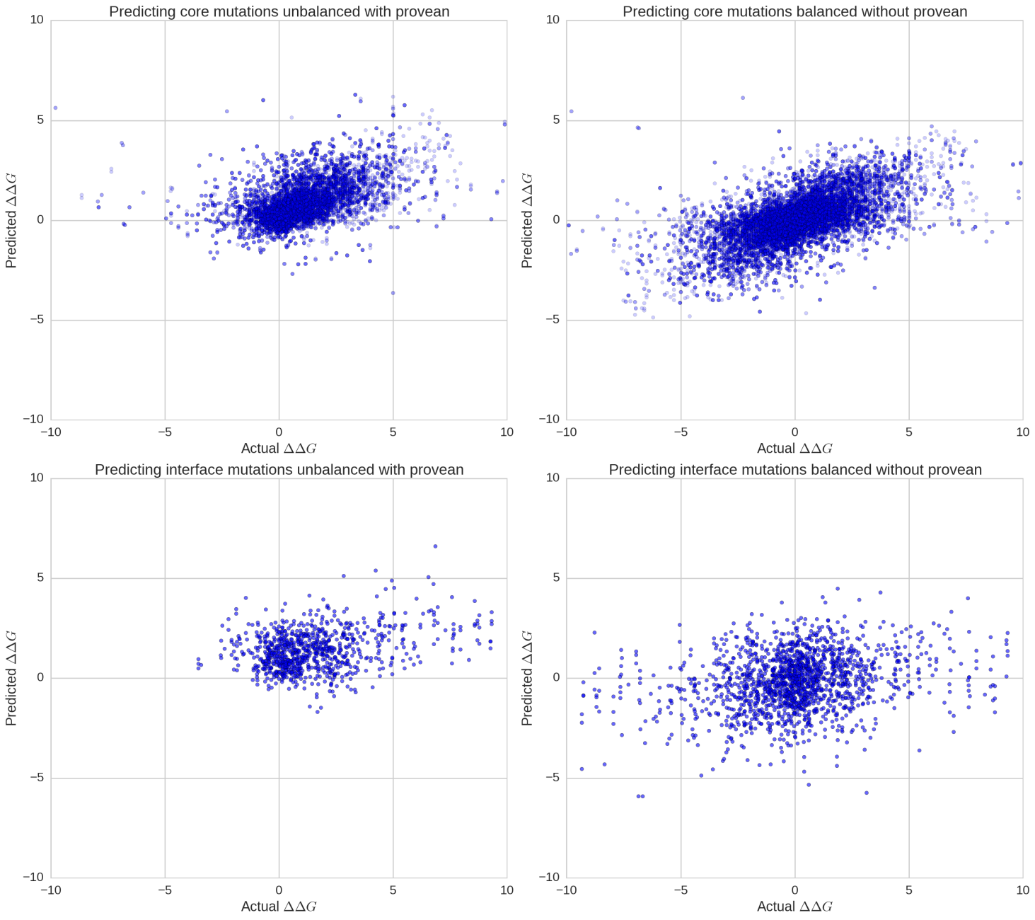
Cross-validation before feature elimination
Provean No reverse mutations
No Provean
Reverse mutations
R² ≈ 0.44
R² ≈ 0.35
Core mutations
R² ≈ 0.37
R² ≈ 0.11
Interface mutations

Slide 43
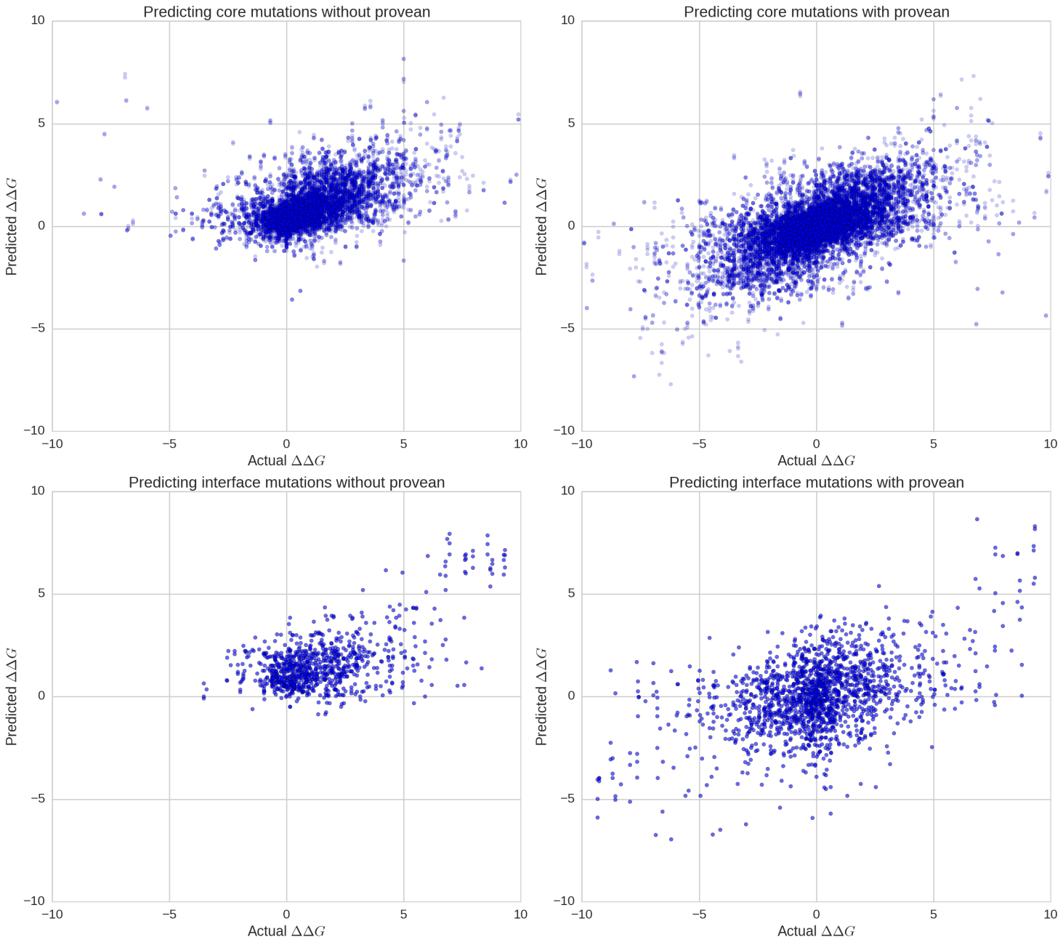
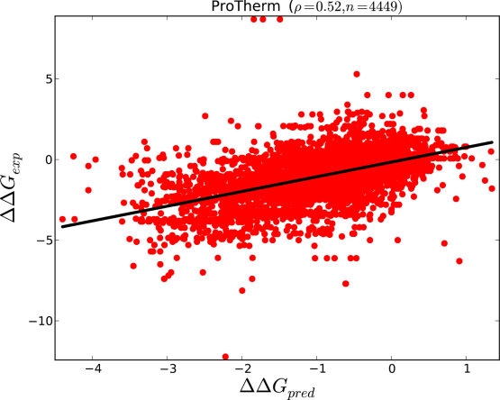
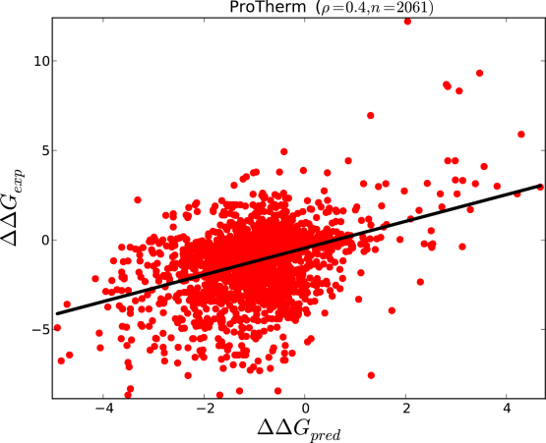
Cross-validation after feature elimination
Provean No reverse mutations
No Provean
Reverse mutations
R² ≈ 0.45
R² ≈ 0.37
Core mutations
R² ≈ 0.58
R² ≈ 0.35
Interface mutations

Slide 44
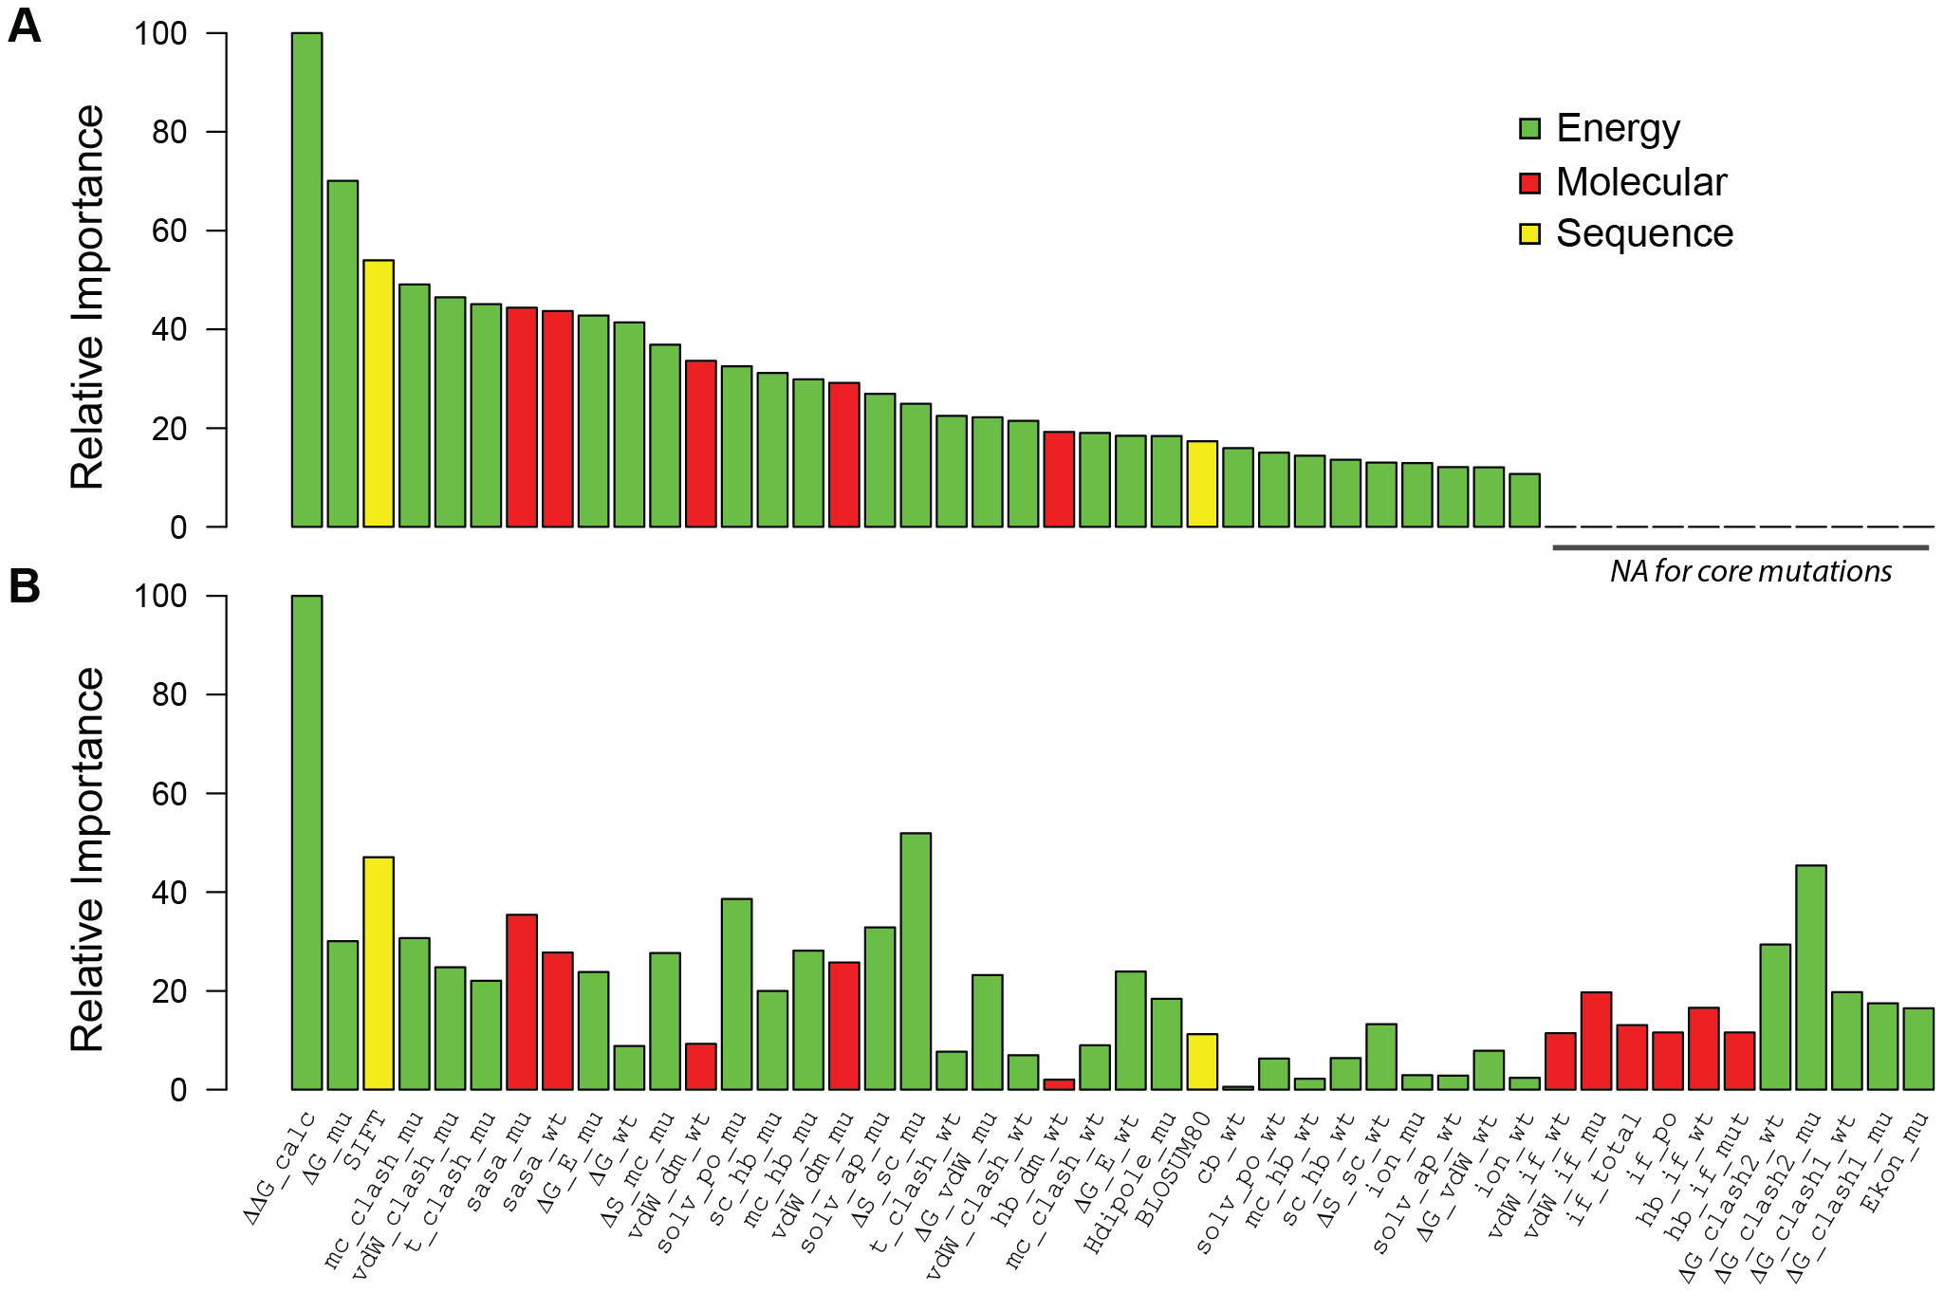
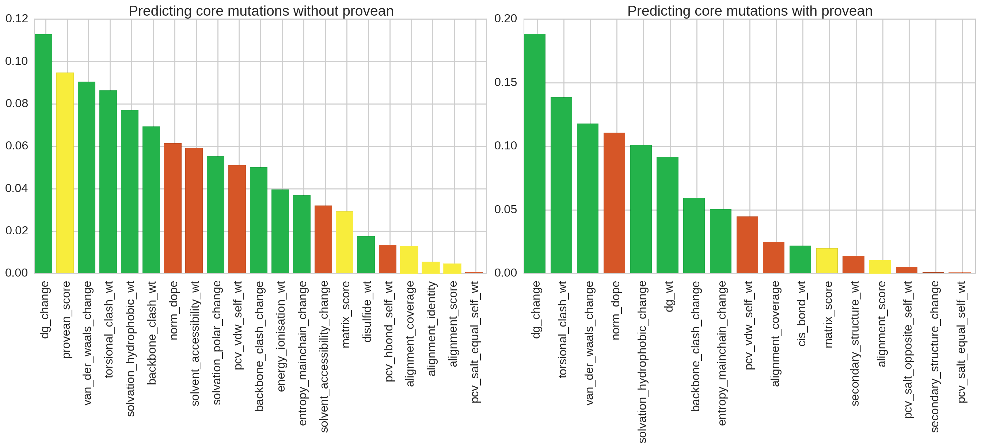
Significant features for core mutations
Provean No reverse mutations
No Provean
Reverse mutations
Relative importance

Slide 45

Significant features for interface mutations
Provean No reverse mutations
No Provean
Reverse mutations
Relative importance

